Slide 1


Slide 2
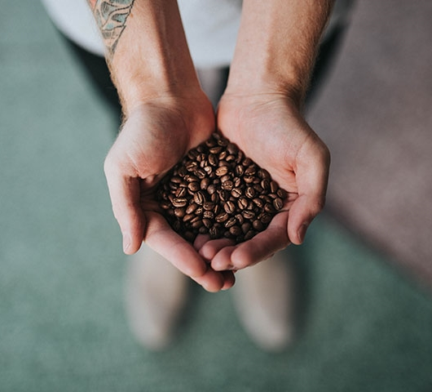

Divider slide
Unlocking the Starbucks Location Strategy
CHRIS TRAN
EMIL RODULFO
TIM BESAW

Slide 3
QUESTIONS
As a popular domestic brand, is Starbucks prevalent across the entire United States?
Does Starbucks offer the same appeal globally?
Are we able to find trends for existing locations using basic census data?
Are we able to determine where a new Starbucks location may open in Greater Orlando?

Slide 4
DATA SOURCES
Starbucks
https://www.kaggle.com/starbucks/store-locations
Census per Zip
https://www.census.gov/data/developers/data-sets.html
Greater Orlando Zip / City
https://www.bestplaces.net/find/zip.aspx?msa=36740&st=fl
Starbucks Company Timeline
https://www.starbucks.com/about-us/company-information/starbucks-company-timeline

Slide 5
Data Cleanup and Exploration - Census Data : Pulled data from an API call, data cleanup to remove non domestic zip codes, vlookup to add state codes

Slide 6
PRESENTATION OVERVIEW
Global Summary
United States Overview
Florida Rundown
Greater Orlando Analysis
Conclusion

Slide 7
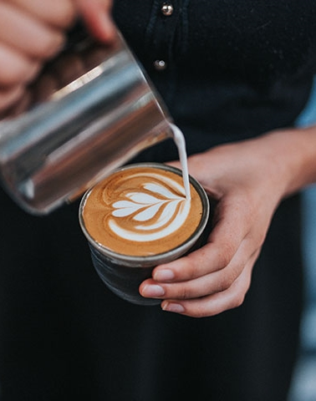
Global Summary

Slide 8
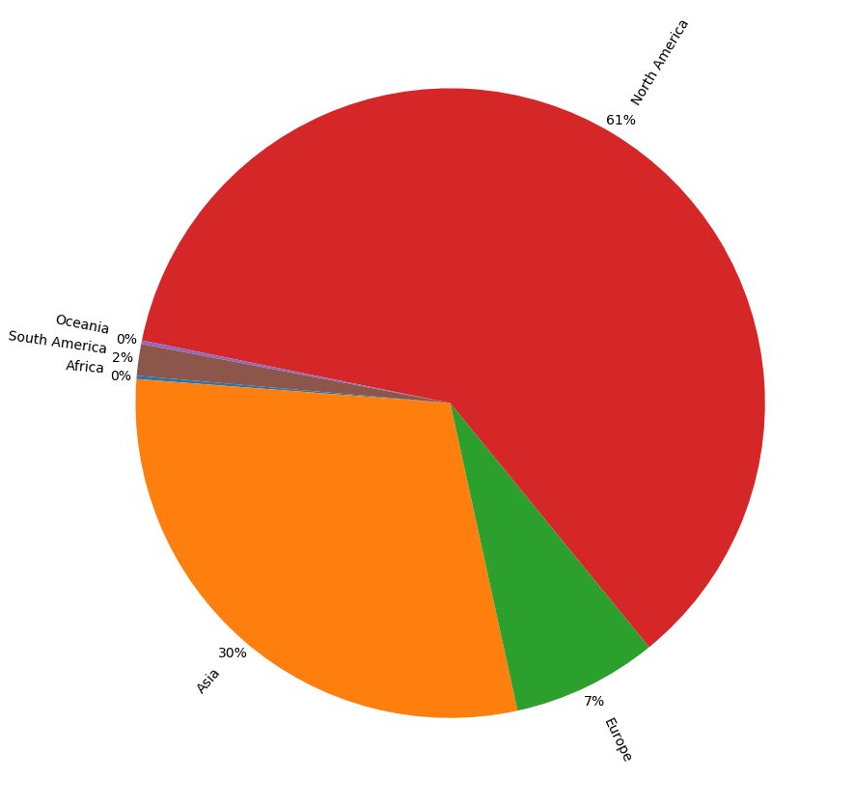
Global Starbucks Locations

Slide 9
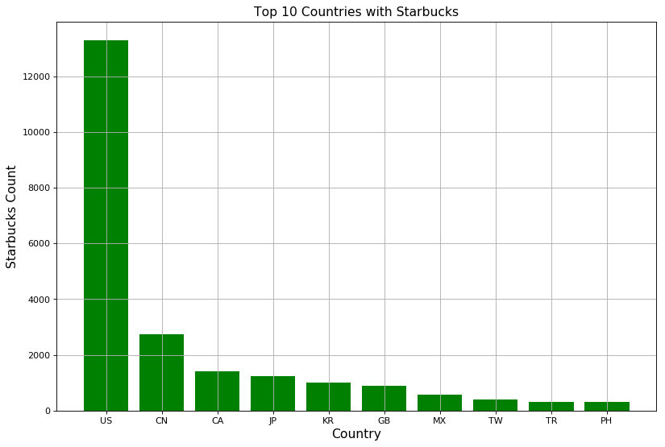
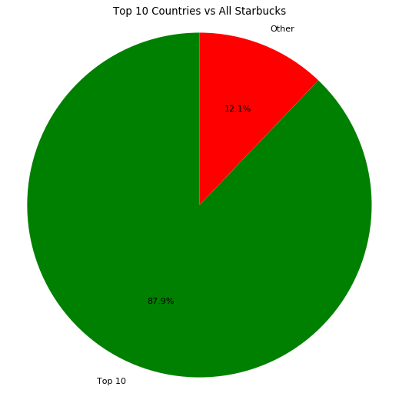
Top 10 Countries

Slide 10
Global Ownership Type

Slide 11
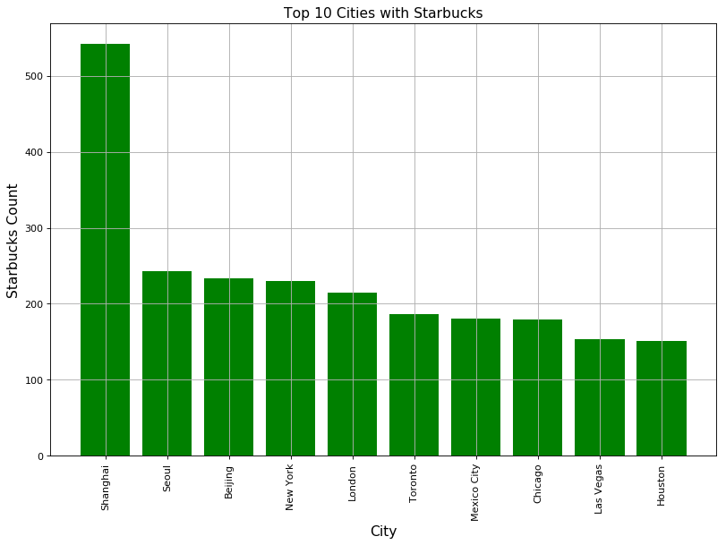
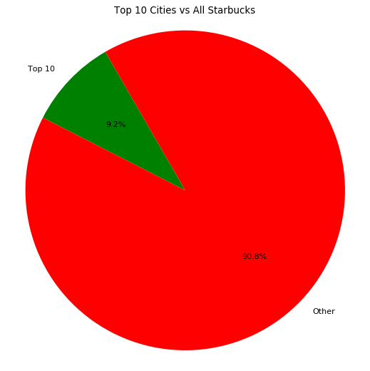
Top 10 Cities in the World

Slide 12
United States Overview

Slide 13
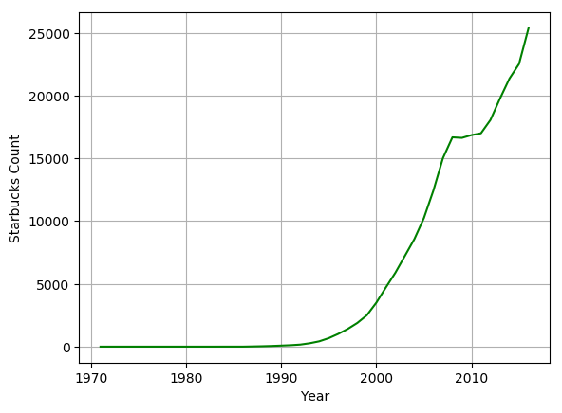
Starbucks Timeline

Slide 14
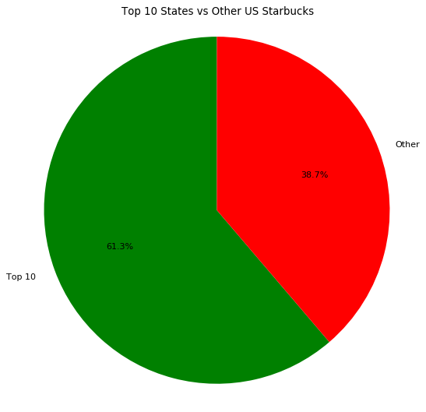
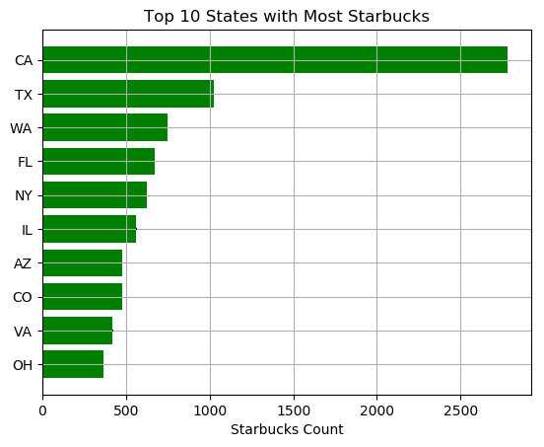
Top 10 States

Slide 15
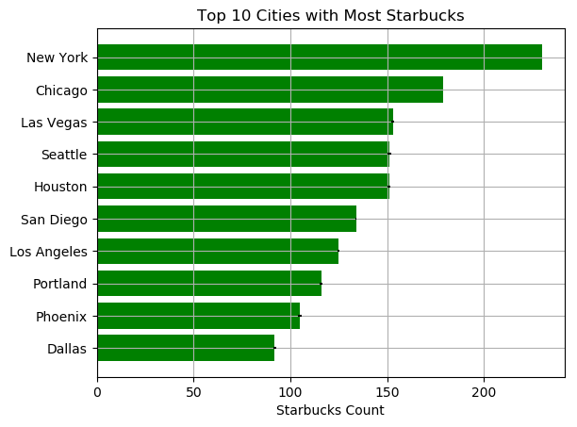
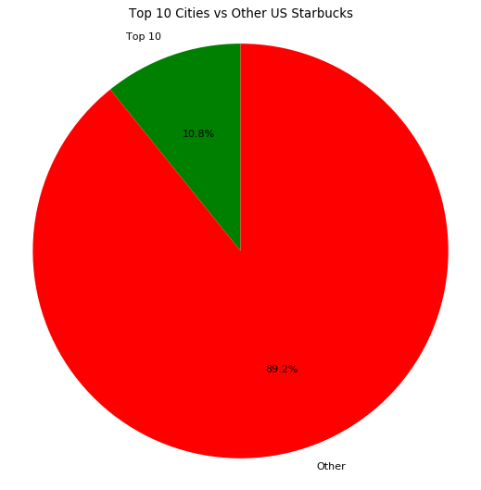
Top 10 Cities

Slide 16
Florida Rundown

Slide 17
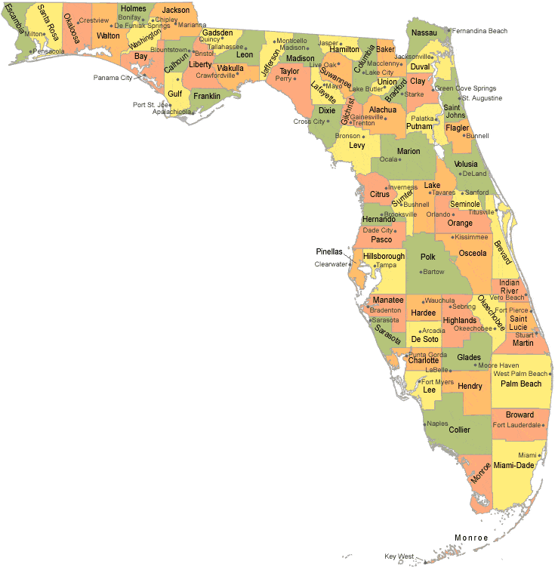
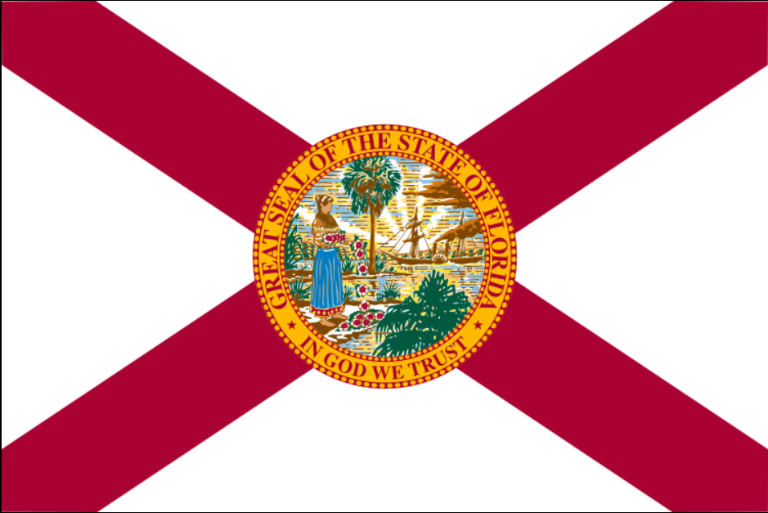
Total Zip Codes | 969
Total Population | 19,932,688
Median Age (Avg) | 42.06
Per Capita Income (Avg) | $27,598.07
Poverty Rate (Avg) | 15.75
Total Starbucks | 660

Slide 18
Florida Top 5 Zip Codes
Zip Code | Area | Starbucks Count
33607 | Tampa | 11
32819 | Dr. Phillips / Bay Hill / Tangelo Park | 11
33139 | Miami Beach | 8
33511 | Brandon / Riverview / Hillsborough | 6
32830 | Lake Buena Vista | 6

Slide 19
Greater Orlando Analysis

Slide 20
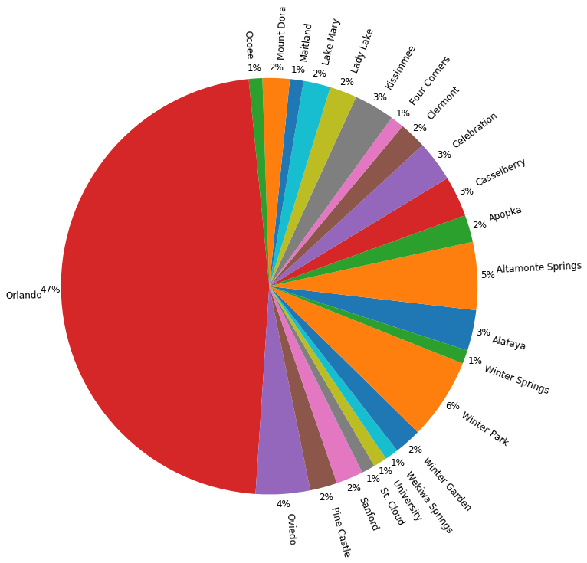
Greater Orlando Starbucks Locations by Area

Slide 21
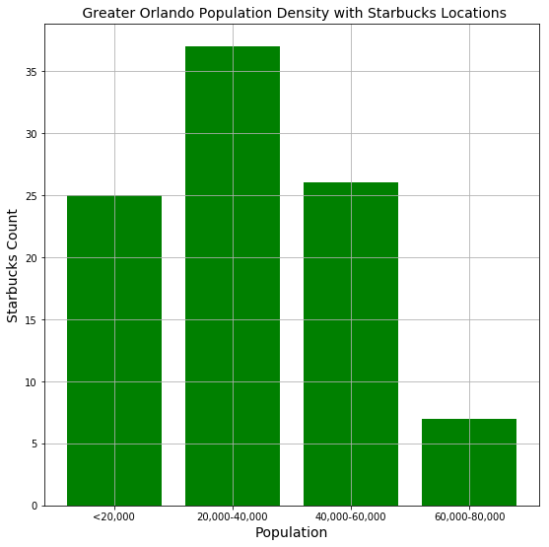
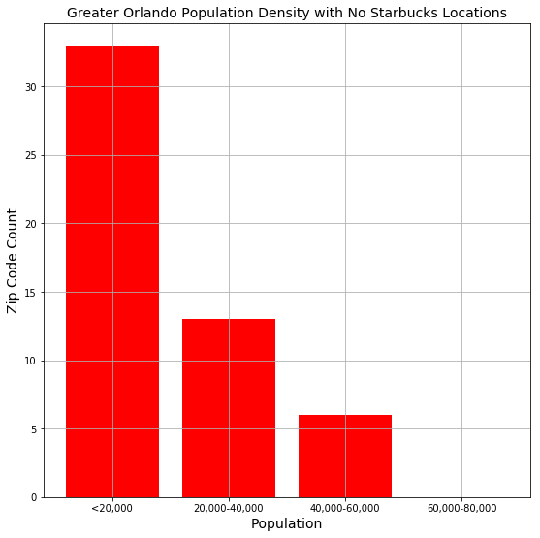
Population Analysis

Slide 22
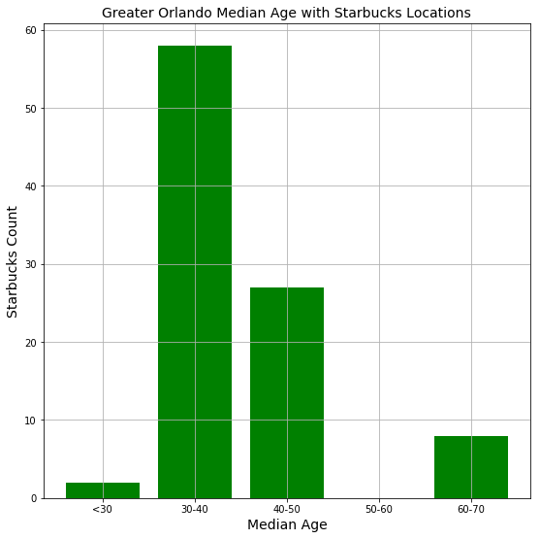
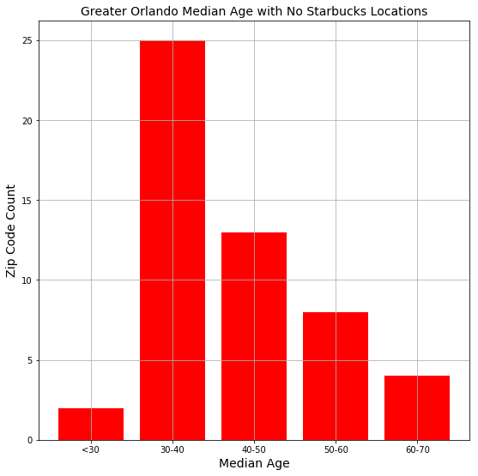
Median Age Analysis

Slide 23
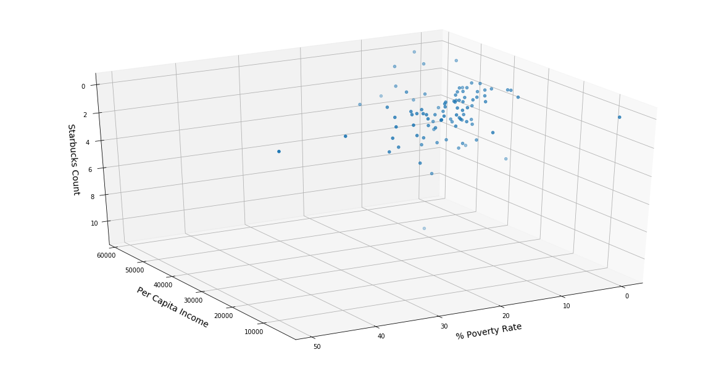
Per Capita Income & Poverty Rate vs Greater Orlando Starbucks Locations

Slide 24
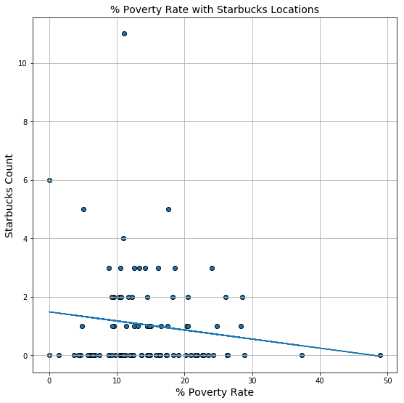
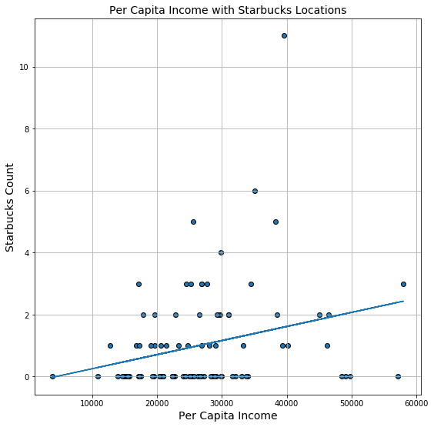
Per Capita Income & Poverty Rate vs Greater Orlando Starbucks Locations

Slide 25
Conclusion

Slide 26
Prospective Search Variables
Population | Median Age | Per Capita Income | Poverty Rate
> 20,000 | 30-40 | > $20,000 | < 20%
Greater Orlando Prospective Zip Codes
Zip Code | Area | Population | Median Age | Per Capita Income | Poverty Rate
32824 | Meadow Woods | 41,857 | 35.8 | 20,981 | 16.19 %
32829 | Orlando | 21,156 | 33.5 | 24,322 | 11.88 %
32832 | Orlando | 21,413 | 31.6 | 29,133 | 6.23%
34772 | St. Cloud | 29,182 | 37.0 | 22,336 | 10.95 %
34786 | Lake Butler | 38,249 | 35.2 | 49,054 | 6.47 %

Slide 27

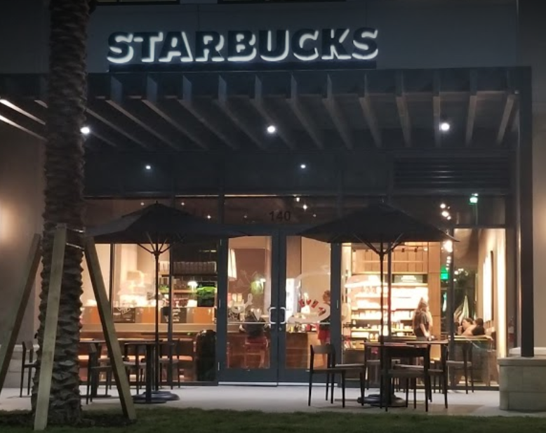
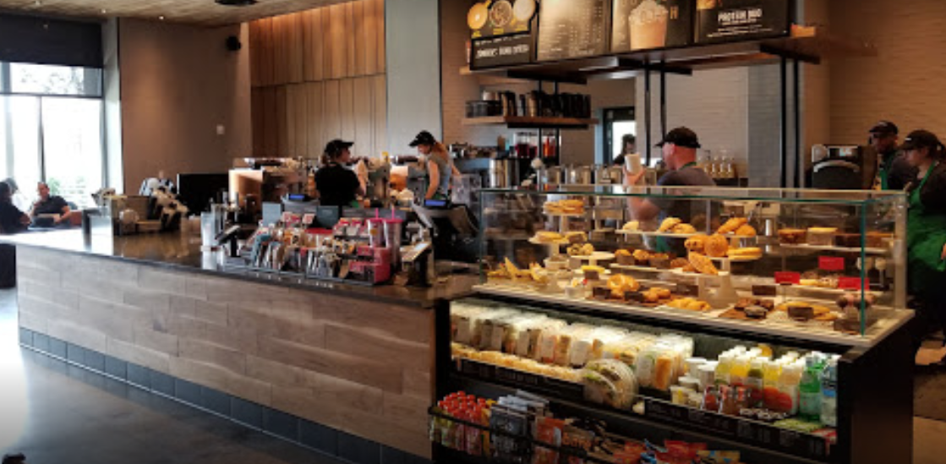
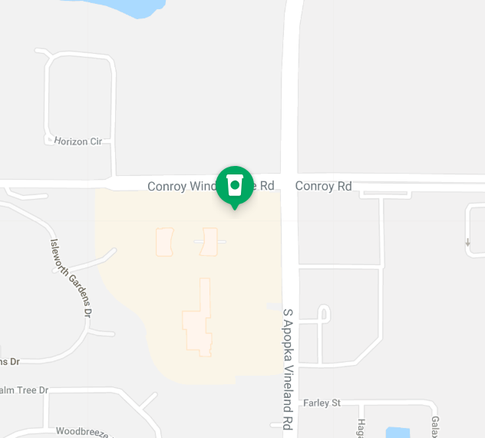
9100 Conroy Windermere Rd Suite 140, Windermere, FL 34786

Slide 28
-Expectations and findings *Data had some outliers(Lake Buena Vista) * -Difficulties * -Any additional questions that came up and what if we had 2 more weeks *Street level data – traffic patterns, foot traffic, geographical *Area barriers of entry *Store level data – standalone or built into plaza (trends, going away from malls) *Commercial data

Slide 29
Q & A
CHRIS TRAN
EMIL RODULFO
TIM BESAW

